Slide 1

Introduction to Java
Object Oriented Programming Language

Slide 2
Introduction
“ Object Oriented Programming Language developed by Sum and Initially called “Oak” by James Gosling

Slide 3
History of Java
Initial Version of Java in 1991
1.0 version in 1995
Open Source in 2006 by (GPL)
Core java completed version in 2007

Slide 4
Java Feature
1. Java is Simple
2. Java is object-oriented
3. Java is Distributed
4. Java is Compiled and Interpreted
5. Java is Robust
6. Java is Secured
7. Java is Dynamic
8. Multithreaded

Slide 5
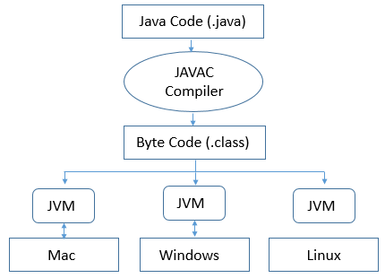
Java Virtual Machine (JVM)
Java Source Program is compiled using the Java Compiler and Convert into Bytecode (.class file)
Bytecode : Highly Optimized set of instruction executed JVM by using JIT (Just In Time) Interpreter.
“ Java Program to write once, Compile Once and run in any platform “

Slide 6
Java vs C/C++
Pure Object Oriented , Structure and Union, Pointer, Operator Over loading

Slide 7
Object Oriented Programming
1. Abstraction
2. Encapsulation
3. Inheritance
I. Simple
Ii. Multi Level
Iii. Hierarchical
6. Polymorphism
I. Method Overloading
Ii. Method Overriding

Slide 8

How to Install java
JDK / JRE ( Version 8)

Slide 9
“Step to Install java”
- JDK version 8

Slide 10
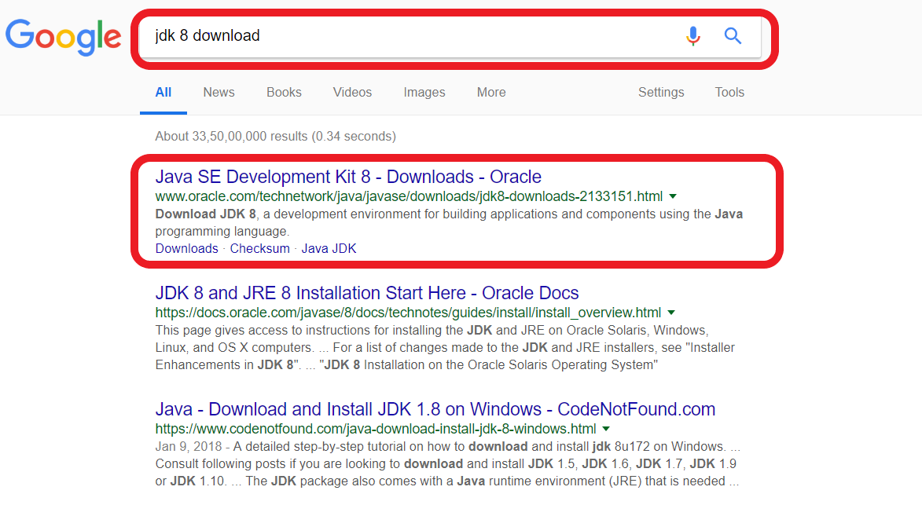

Slide 11
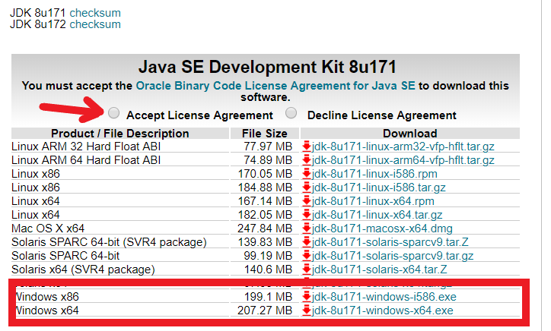
Download JDK (32bit / 64 bit)

Slide 12
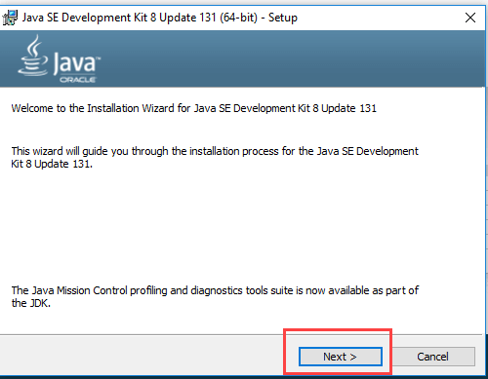
Install on Computer

Slide 13
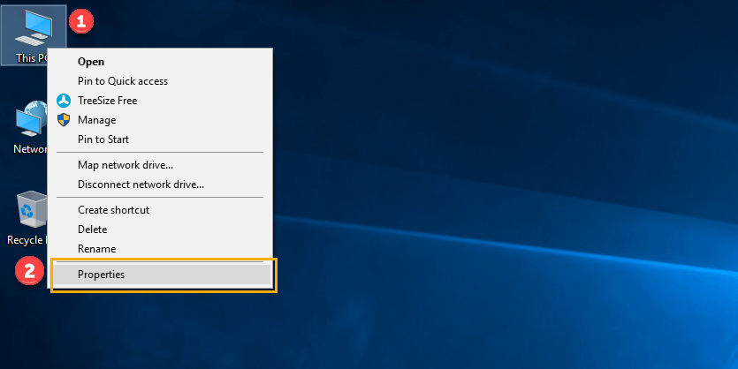
Set Environment Variable

Slide 14
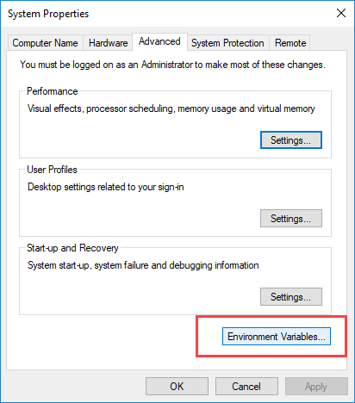
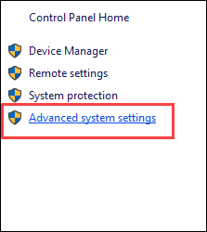

Slide 15
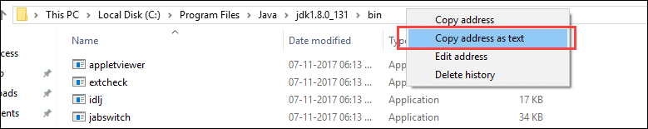
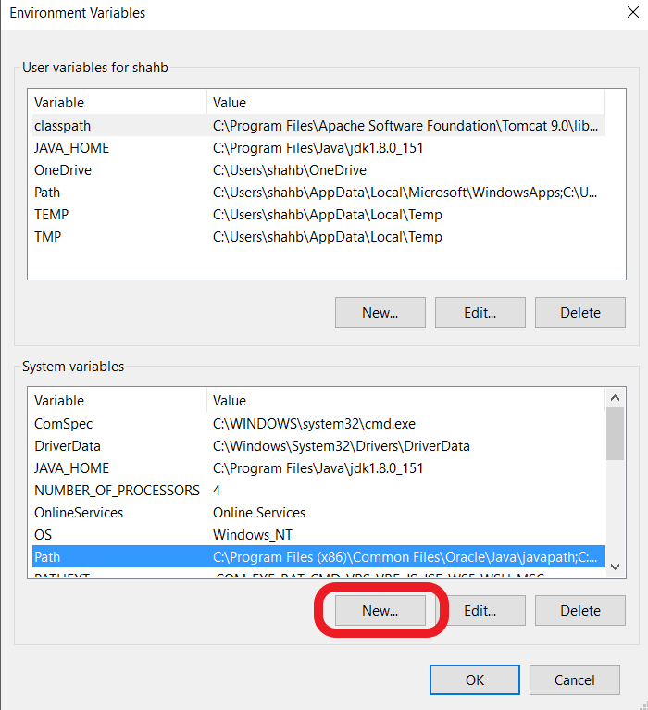

Slide 16
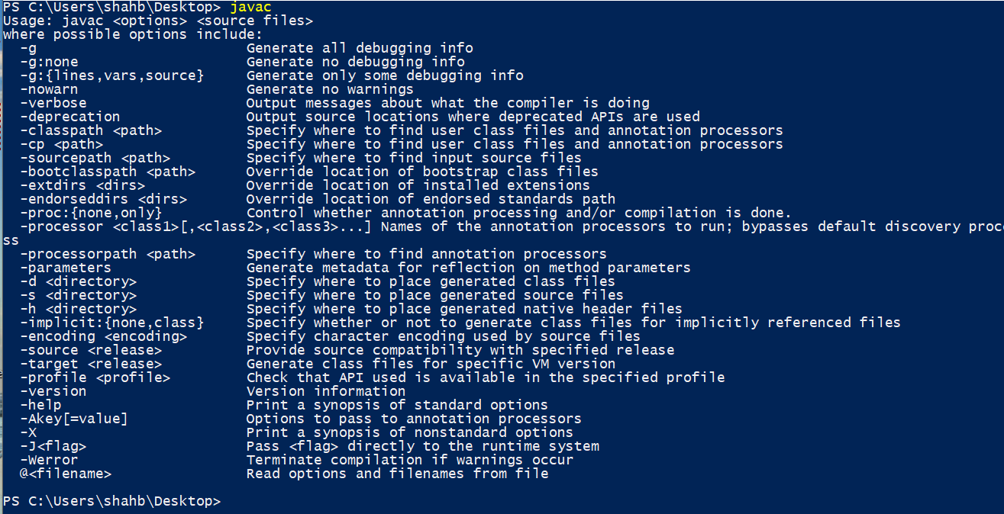
Run Javac on CMD

Slide 17
Write and Compile once, Run any time any where.
-JAVA

Slide 18
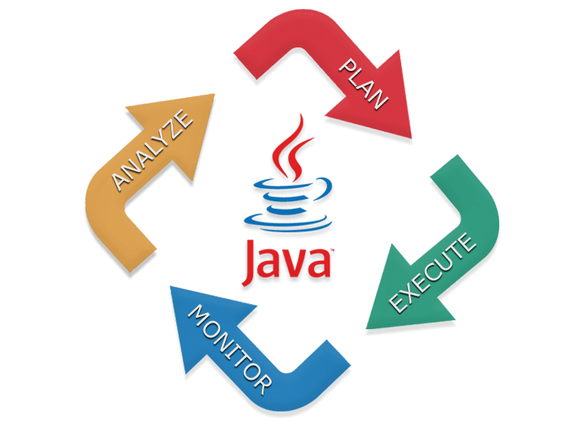
Thanks!
Shah Bhavay

